Slide 1



Rushika_Kale_Portfolio
View in Power BI
Last data refresh:
3/23/2021 2:06:25 PM India Standard Time
Downloaded at:
3/23/2021 6:48:07 PM India Standard Time

Slide 2
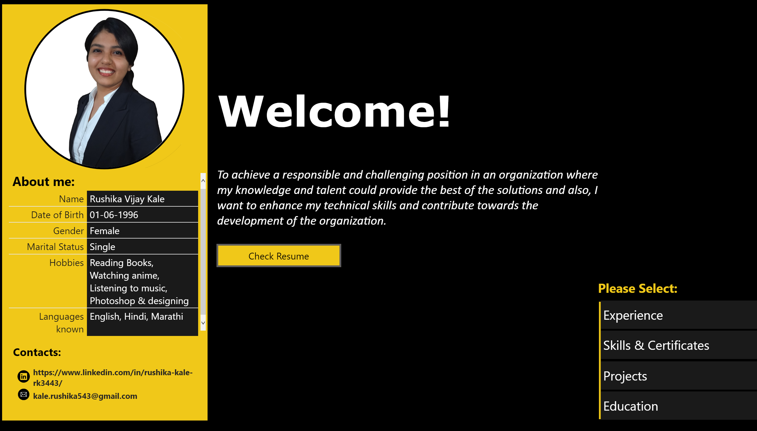
Portfolio
Notes:
basicShape
No alt text provided.
basicShape
No alt text provided.
textbox
No alt text provided.
tableEx
No alt text provided.
textbox
No alt text provided.
image
No alt text provided.
image
No alt text provided.
tableEx
No alt text provided.
textbox
No alt text provided.
textbox
No alt text provided.
actionButton
No alt text provided.
actionButton
No alt text provided.
actionButton
No alt text provided.
actionButton
No alt text provided.
basicShape
No alt text provided.
basicShape
No alt text provided.
basicShape
No alt text provided.
basicShape
No alt text provided.
basicShape
No alt text provided.
textbox
No alt text provided.
actionButton
No alt text provided.
image
No alt text provided.

Slide 3
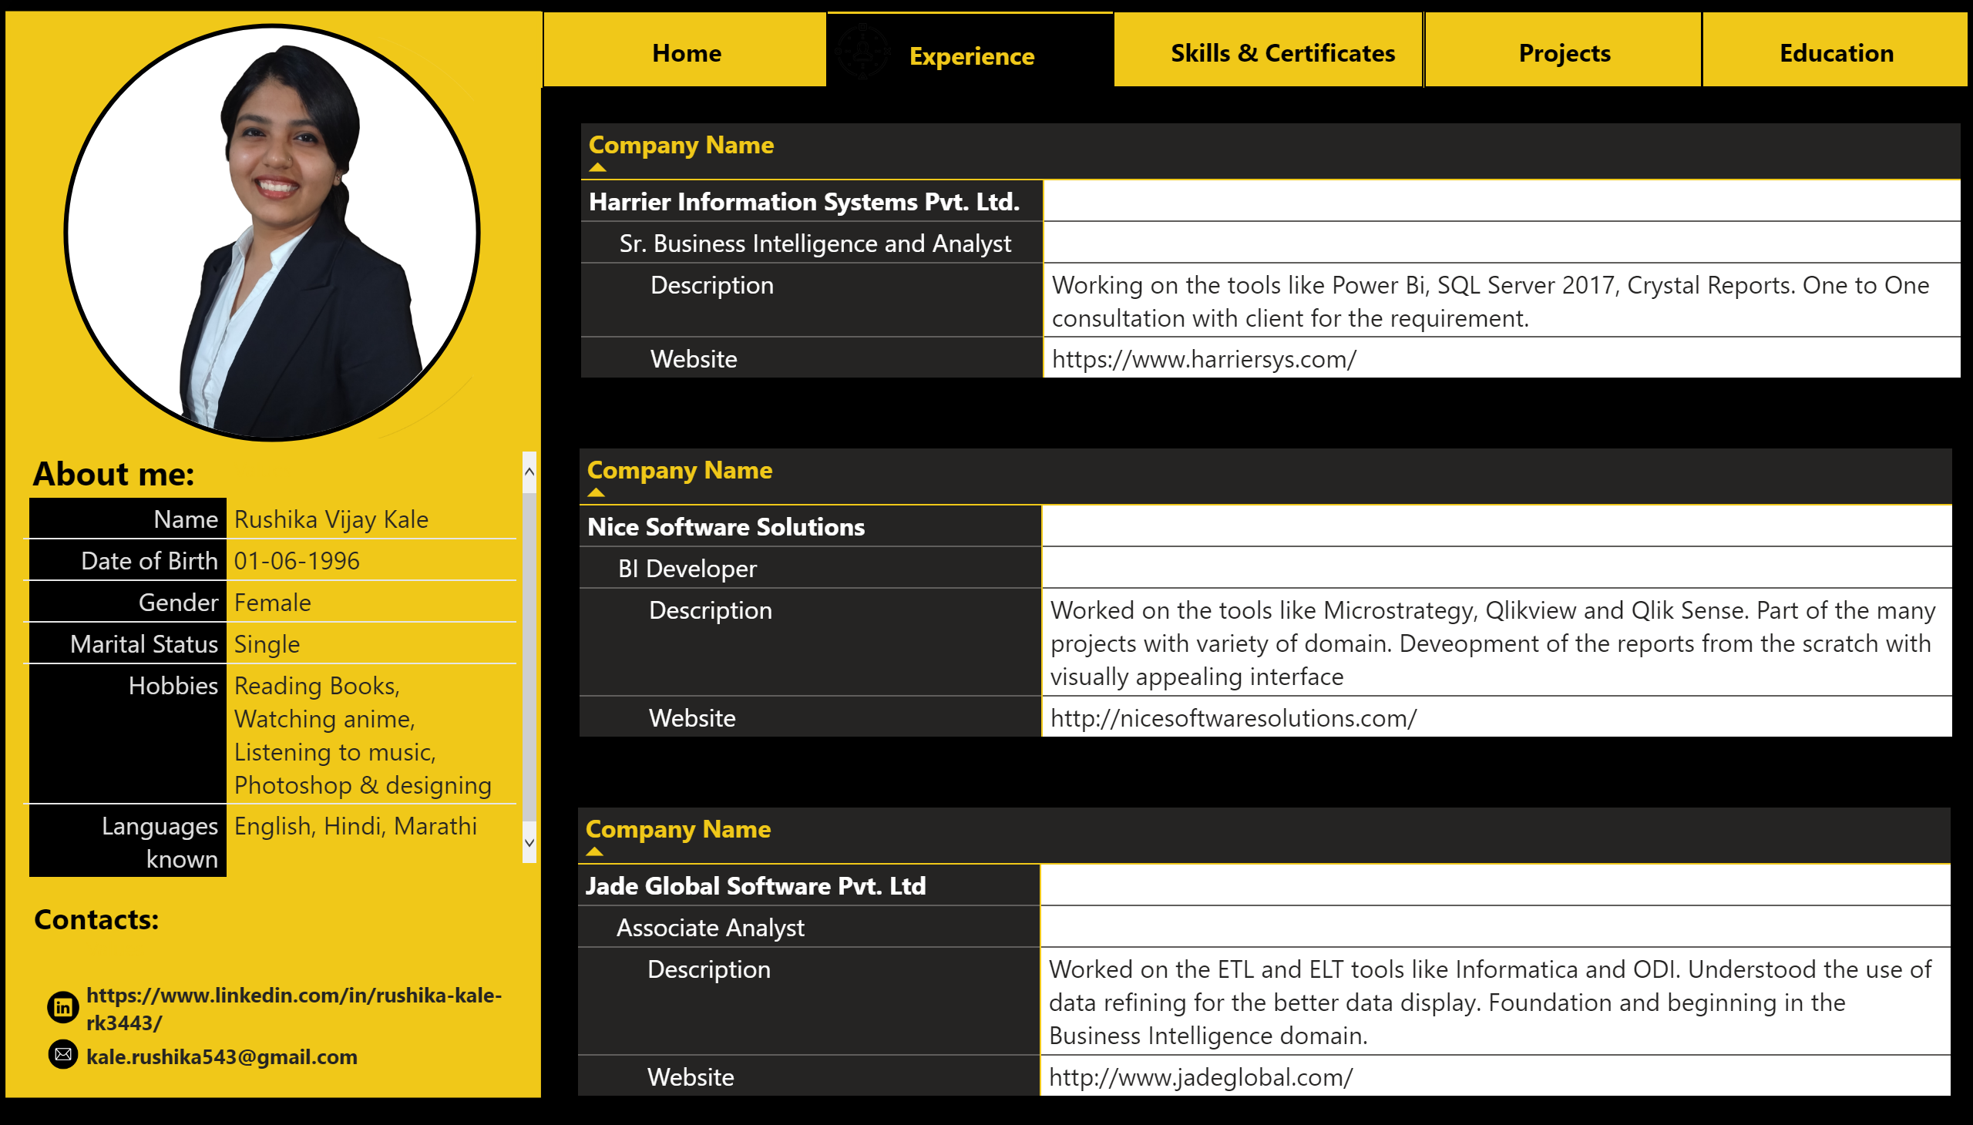
Past Experience
Notes:
basicShape
No alt text provided.
basicShape
No alt text provided.
textbox
No alt text provided.
tableEx
No alt text provided.
textbox
No alt text provided.
image
No alt text provided.
image
No alt text provided.
tableEx
No alt text provided.
basicShape
No alt text provided.
image
No alt text provided.
actionButton
No alt text provided.
actionButton
No alt text provided.
actionButton
No alt text provided.
actionButton
No alt text provided.
actionButton
No alt text provided.
image
No alt text provided.
image
No alt text provided.
image
No alt text provided.
image
No alt text provided.
image
No alt text provided.
pivotTable
No alt text provided.
pivotTable
No alt text provided.
image
No alt text provided.
pivotTable
No alt text provided.

Slide 4
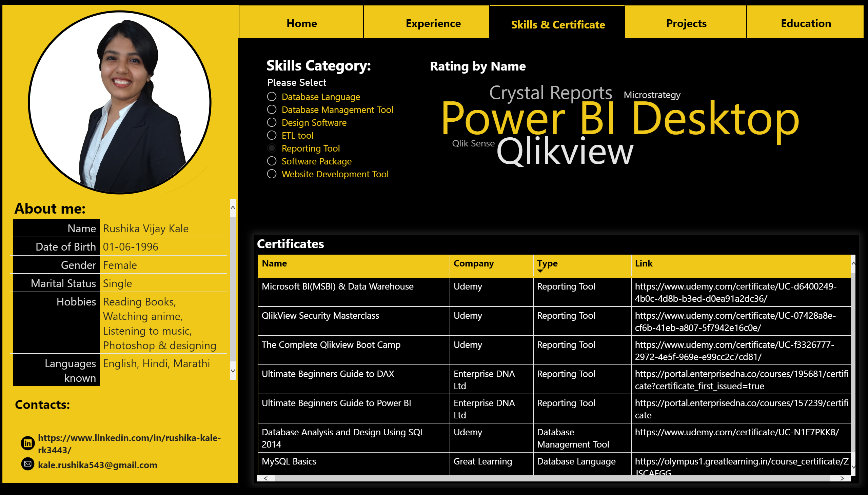
Skills
Notes:
basicShape
No alt text provided.
image
No alt text provided.
actionButton
No alt text provided.
actionButton
No alt text provided.
actionButton
No alt text provided.
actionButton
No alt text provided.
actionButton
No alt text provided.
image
No alt text provided.
image
No alt text provided.
image
No alt text provided.
image
No alt text provided.
textbox
No alt text provided.
image
No alt text provided.
basicShape
No alt text provided.
basicShape
No alt text provided.
textbox
No alt text provided.
textbox
No alt text provided.
image
No alt text provided.
image
No alt text provided.
tableEx
No alt text provided.
tableEx
No alt text provided.
slicer
No alt text provided.
Certificates
No alt text provided.
WordCloud1447959067750
No alt text provided.

Slide 5
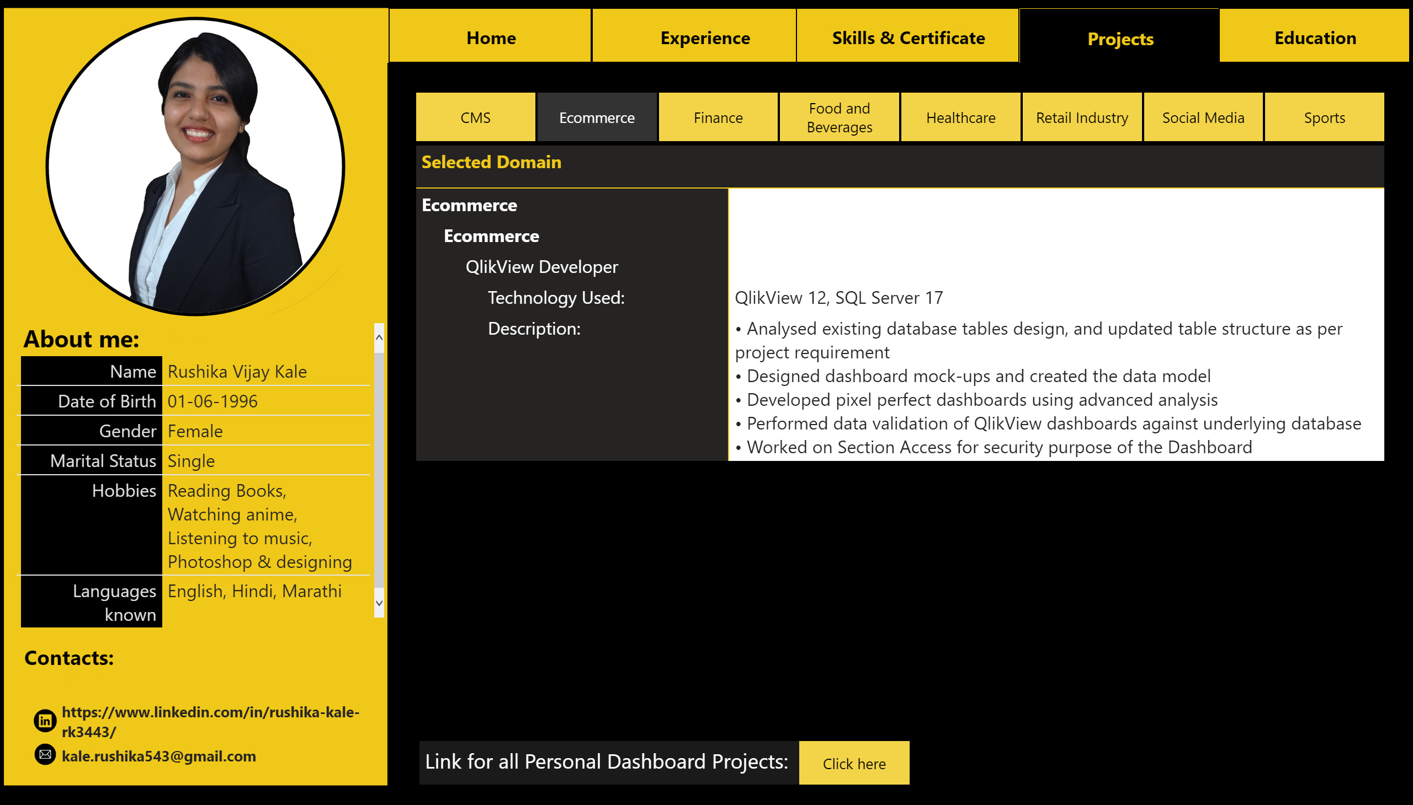
Projects
Notes:
textbox
No alt text provided.
actionButton
No alt text provided.
basicShape
No alt text provided.
image
No alt text provided.
actionButton
No alt text provided.
actionButton
No alt text provided.
actionButton
No alt text provided.
actionButton
No alt text provided.
actionButton
No alt text provided.
image
No alt text provided.
image
No alt text provided.
image
No alt text provided.
image
No alt text provided.
image
No alt text provided.
basicShape
No alt text provided.
basicShape
No alt text provided.
textbox
No alt text provided.
textbox
No alt text provided.
image
No alt text provided.
image
No alt text provided.
tableEx
No alt text provided.
tableEx
No alt text provided.
pivotTable
No alt text provided.
slicer
No alt text provided.

Slide 6
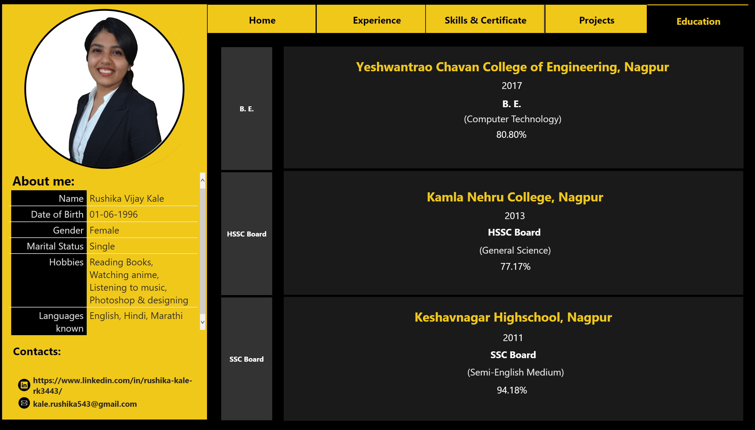
Education
Notes:
basicShape
No alt text provided.
basicShape
No alt text provided.
textbox
No alt text provided.
tableEx
No alt text provided.
textbox
No alt text provided.
image
No alt text provided.
image
No alt text provided.
tableEx
No alt text provided.
slicer
No alt text provided.
card
No alt text provided.
card
No alt text provided.
B. E.
No alt text provided.
card
No alt text provided.
card
No alt text provided.
card
No alt text provided.
card
No alt text provided.
B. E.
No alt text provided.
card
No alt text provided.
card
No alt text provided.
card
No alt text provided.
card
No alt text provided.
B. E.
No alt text provided.
card
No alt text provided.
card
No alt text provided.
basicShape
No alt text provided.
basicShape
No alt text provided.
basicShape
No alt text provided.
basicShape
No alt text provided.
image
No alt text provided.
actionButton
No alt text provided.
actionButton
No alt text provided.
actionButton
No alt text provided.
actionButton
No alt text provided.
actionButton
No alt text provided.
image
No alt text provided.
image
No alt text provided.
image
No alt text provided.
image
No alt text provided.
image
No alt text provided.

